Slide 1



CE7454 Object Detection of Ship Images using Deep learning Techniques
15 November 2018
Xu Yan,
Ong Shen Hoong Kevin,
Wang Hong Tao

Slide 2

Objective:
To be able to detect and locate ships from satellite images as quickly as possible using Deep Learning techniques
Source: https://upload.wikimedia.org/wikipedia/commons/7/7c/Kaggle_logo.png

Slide 3
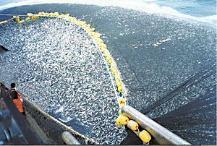
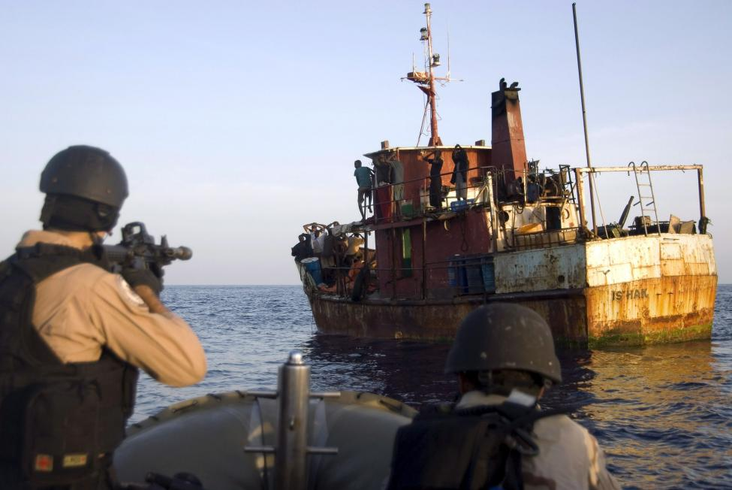

Motivation
Identification of illegal Activities
Source: https://worldoceanreview.com/wp-content/uploads/2013/02/wor2_k3c-s75_3-25_verfolgungsjagd_vor_suedkorea.jpg , https://upload.wikimedia.org/wikipedia/commons/thumb/0/00/Chilean_purse_seine.jpg/300px-Chilean_purse_seine.jpg

Slide 4
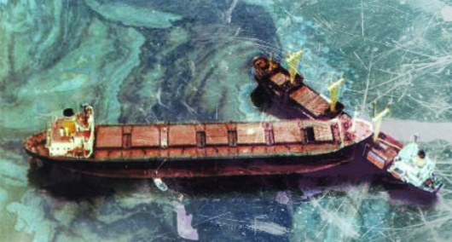
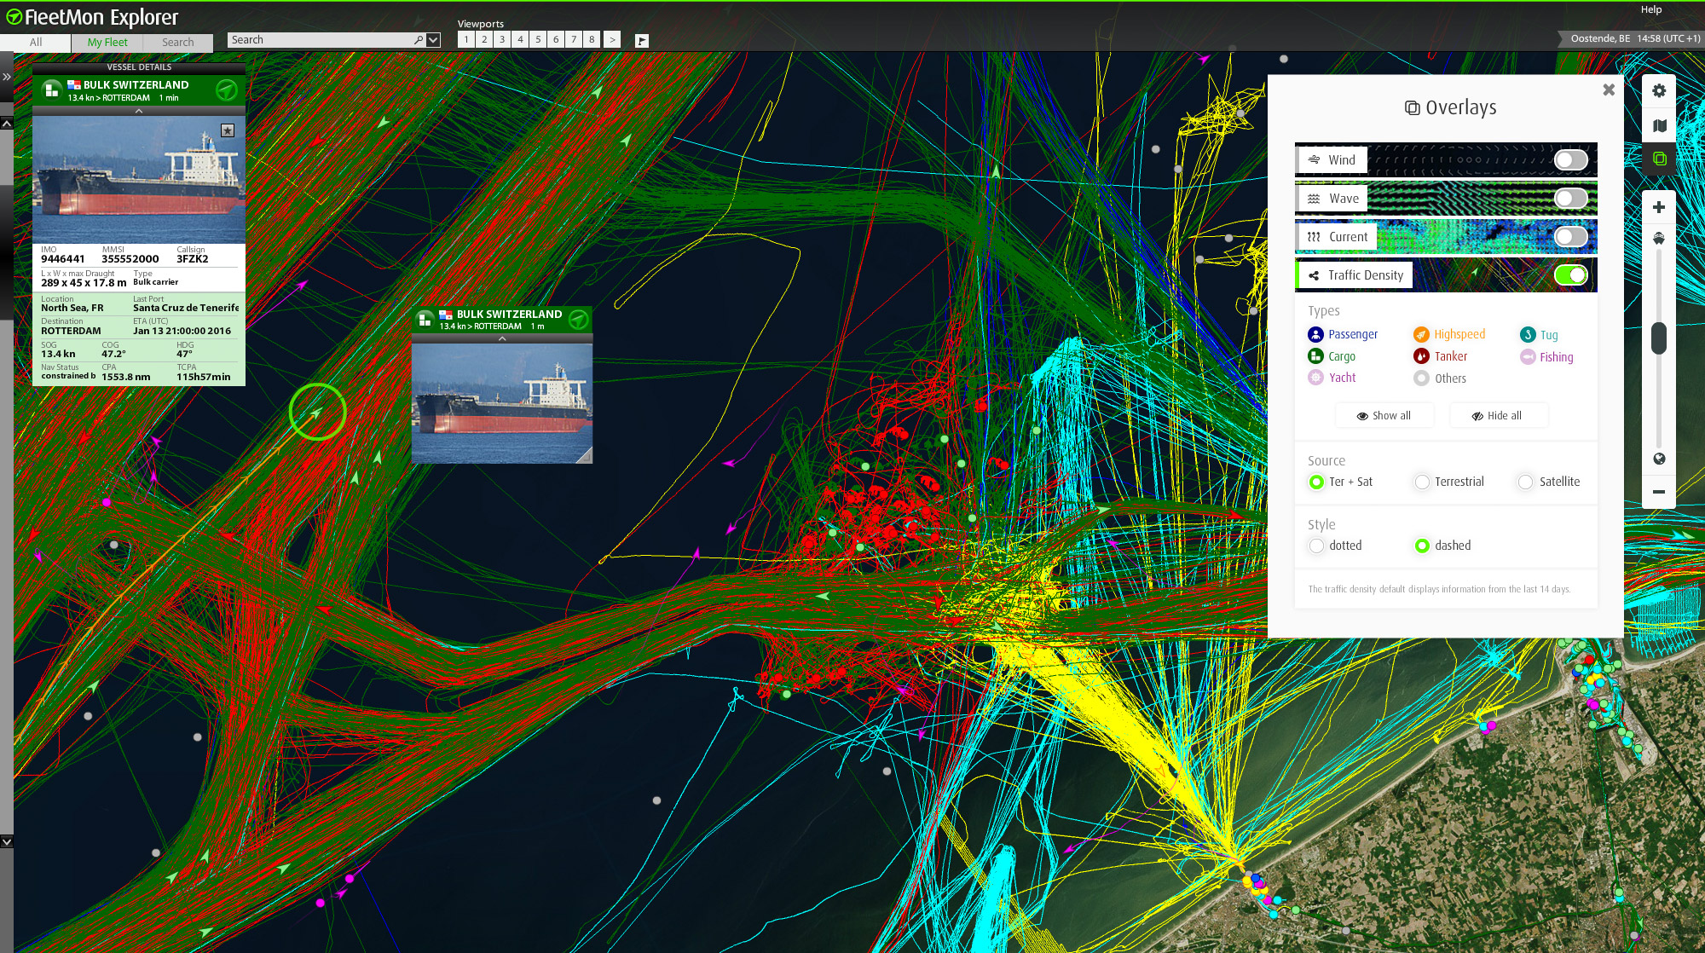

Motivation
Maritime Traffic Monitoring
This Photo by Unknown Author is licensed under CC BY-SA
Source: https://worldoceanreview.com/wp-content/uploads/2013/02/wor2_k3c-s75_3-25_verfolgungsjagd_vor_suedkorea.jpg , https://steamuserimages-a.akamaihd.net/ , https://officerofthewatch.files.wordpress.com/2012/09/2012-09-10-figure-1carrier-collision-causes-oil-spill-in-singapore1.jpg?w=610

Slide 5
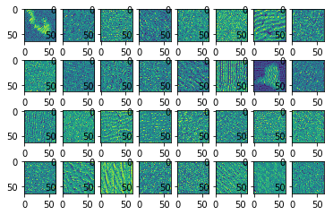
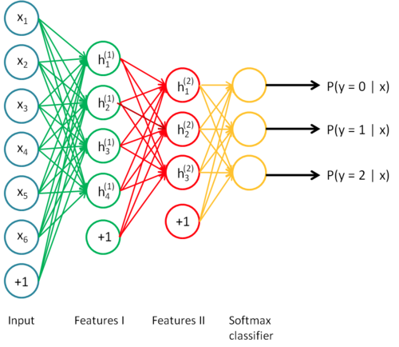
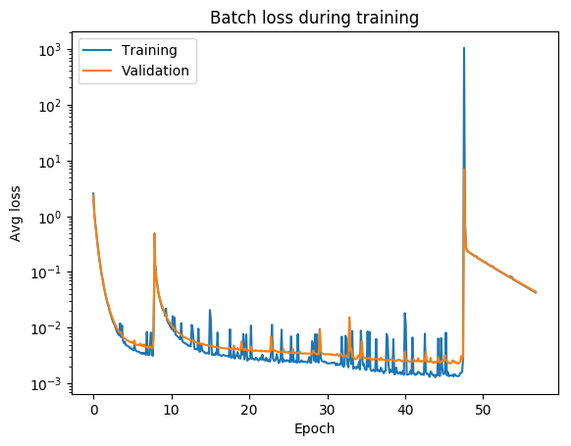

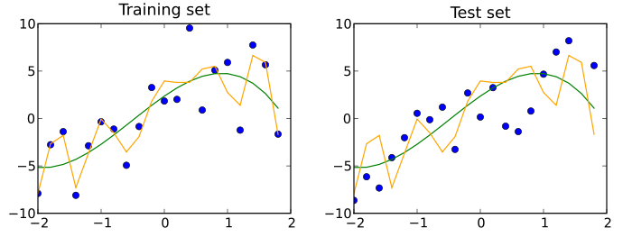
Deep learning Steps
Hidden Layer Visualization
1
3
5
Data Cleaning
+
Prepare
Test Data Validation
Data
Acquisition
+
Exploration
Train model
Analysis + Improve
2
4
Source: https://agsft.com/wp-content/uploads/2016/06/FilterBigData.png , https://cdn-images-1.medium.com/max/1600/1*fk2ZjHyqYH04rLTgvQYs4A.png ,

Slide 6
Deep learning Steps
1
Data Cleaning
+
Prepare
Data
Acquisition
+
Exploration
2
Source: https://agsft.com/wp-content/uploads/2016/06/FilterBigData.png , https://cdn-images-1.medium.com/max/1600/1*fk2ZjHyqYH04rLTgvQYs4A.png ,

Slide 7
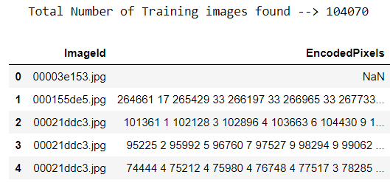
Data Acquisition + Exploration
Decoding required to extract data → Run-Length-Encoding
NULL values are present → Image no ship
Minor data cleaning required

Slide 8
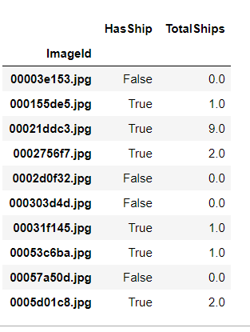
Data Acquisition + Exploration
4 types of data becomes available:
Presence of Ship (F/T)
Number of Ships
Location of Ships
Infer Bounding Box

Slide 9
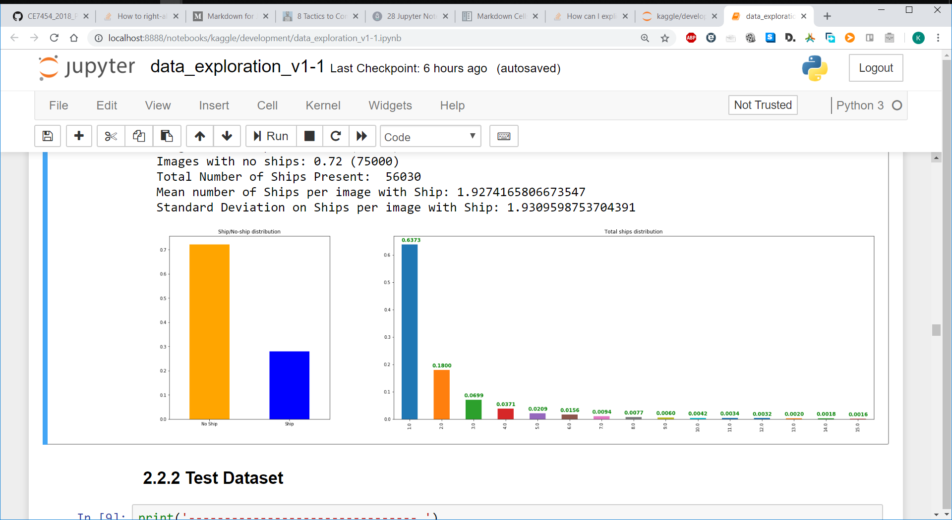
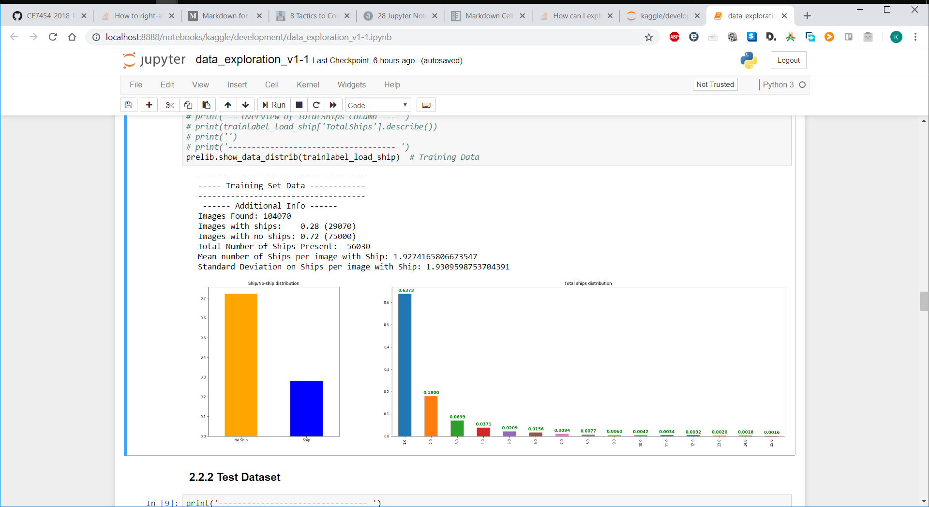
Data Acquisition + Exploration
75%
28%

Slide 10
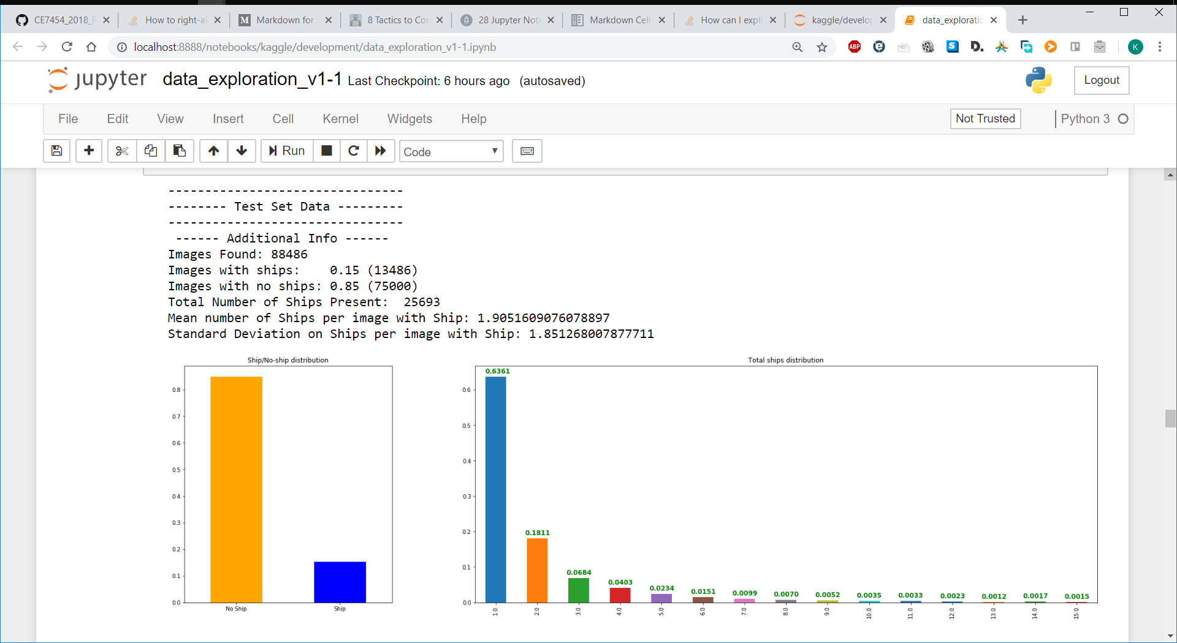
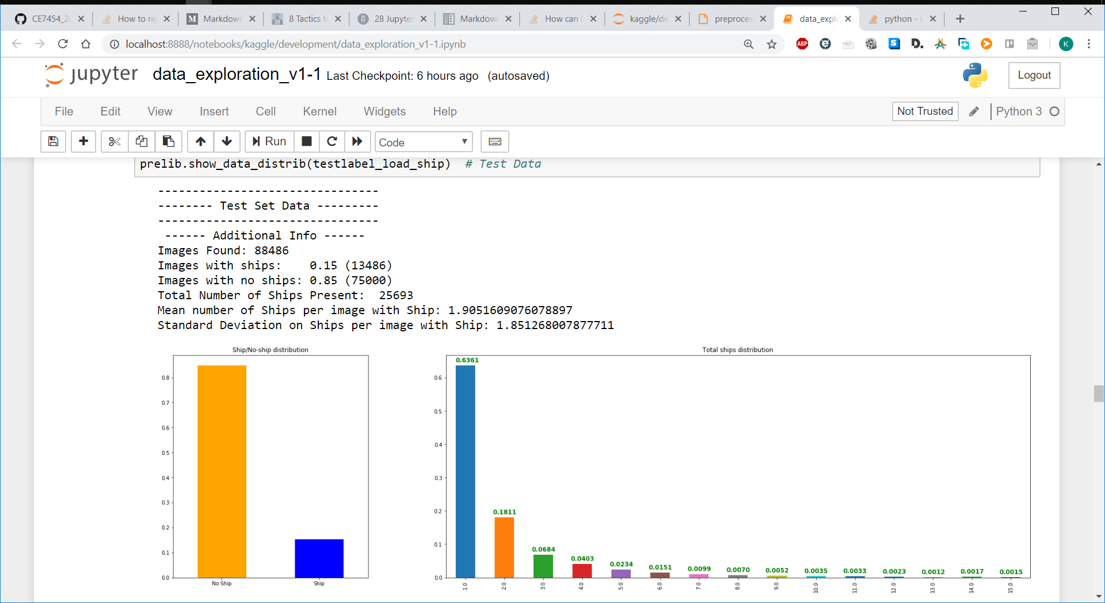
Data Acquisition + Exploration
85%
28%
15%

Slide 11
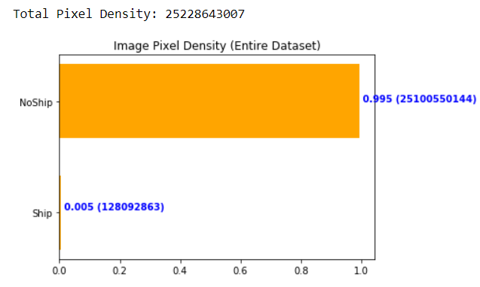
Data Acquisition + Exploration
Huge Difficulty of Ship Detection
Could be further improved by obtaining more data

Slide 12
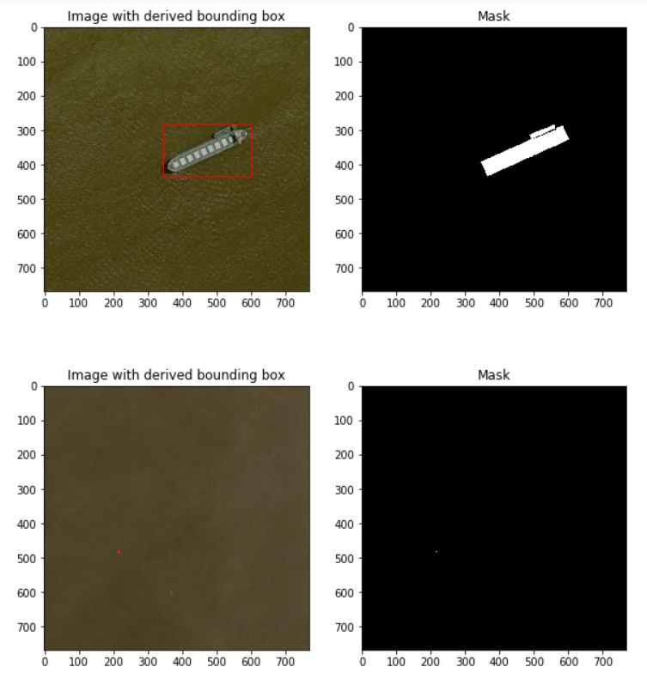
Example of Detection Complexity
2 types of complexity

Slide 13
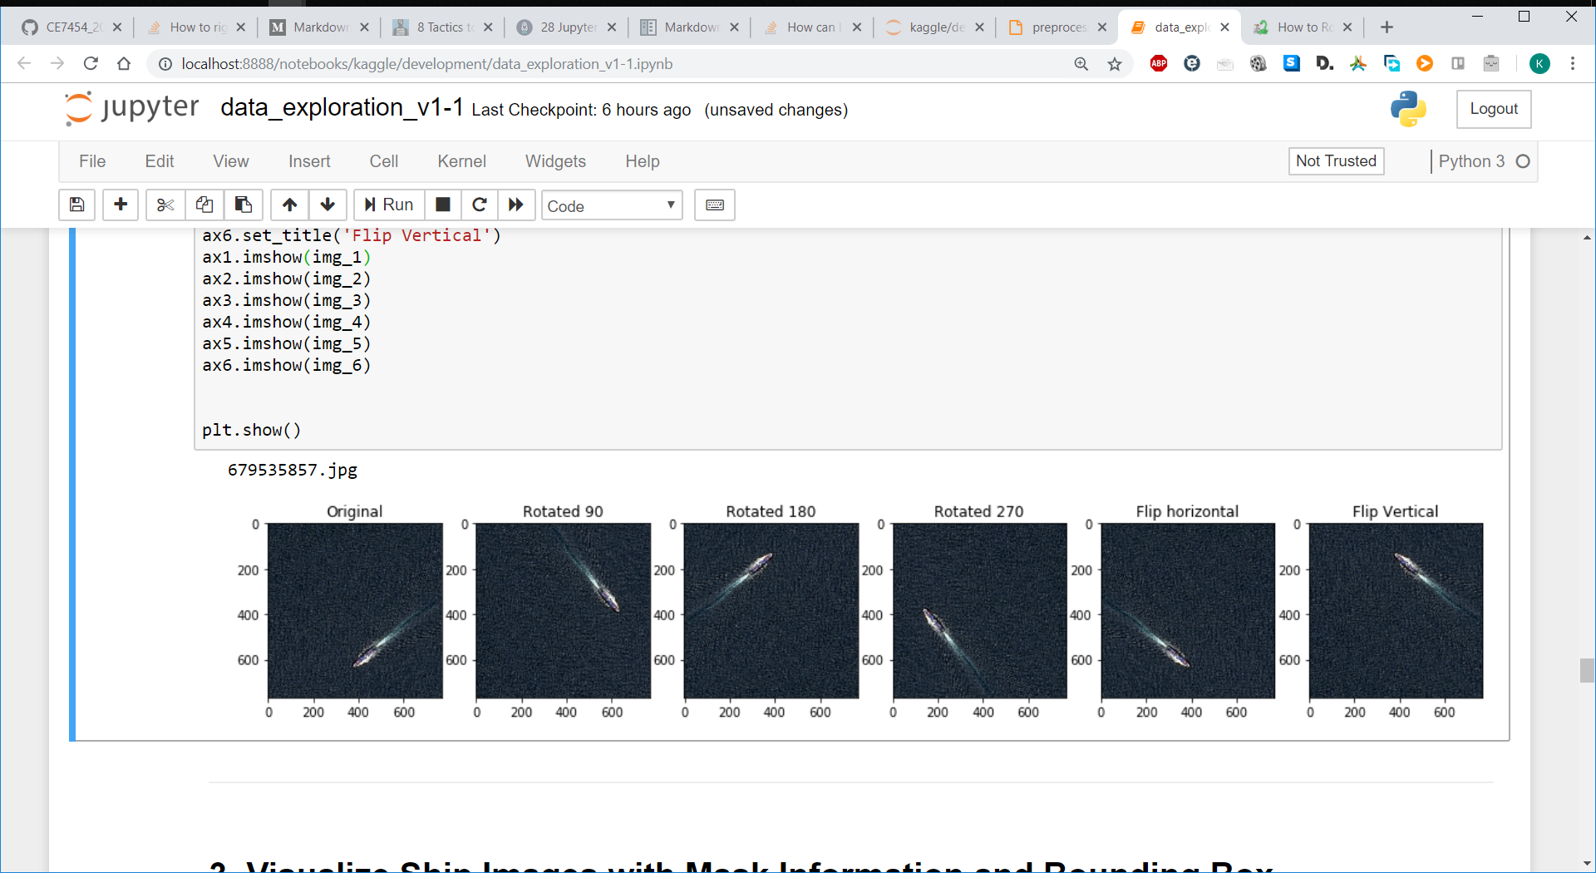
Data Preparation
Image Requires Balancing to avoid a biased classifier
Easily Generate more ship image data (from 30% to ~66%)

Slide 14
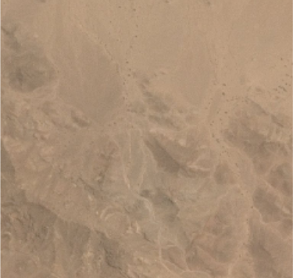
Custom CNN Architecture
128, 128,
(256, 256, 3)
(128, 128, 3)
1
Ship
Detected
No Ship
Input Image
(256, 256, 3)
Custom CNN Layers
Fully Connected Layers
Batch Size 32, Sample Size 10000
Preliminary architecture design search
Batch Norm
Conv2D
Dense Layer
Max Pool
Flatten

Slide 15
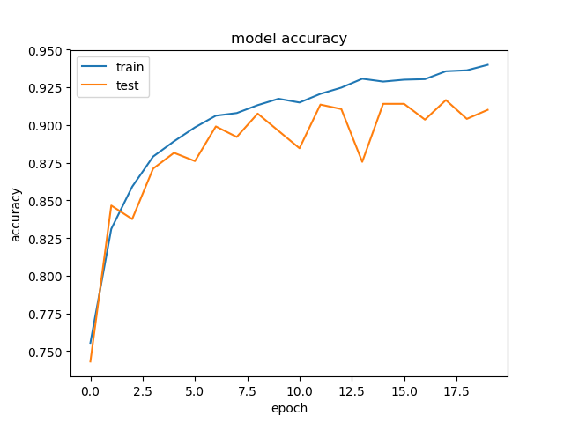
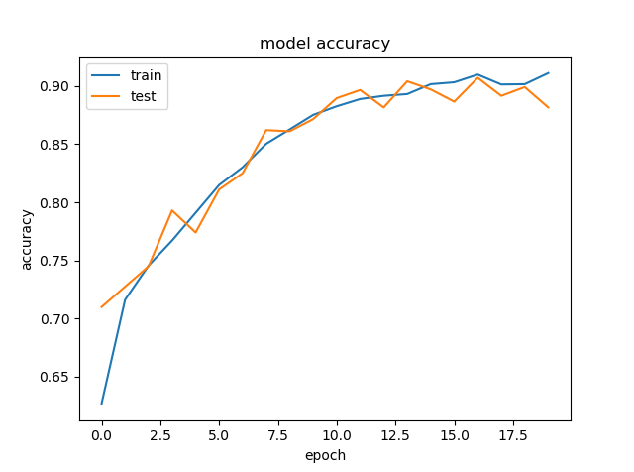
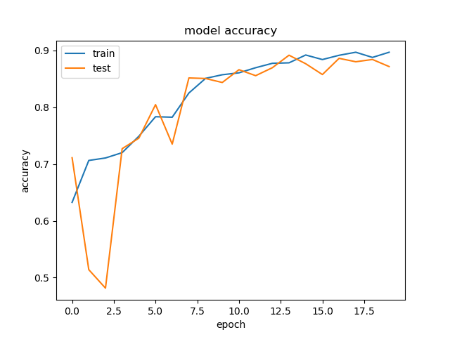
Test with Custom CNN
Batch Normalization
Normal Initialization
Diff: ~0.03
Diff: 0.04
3 Layers
w/BN
3 Layers
w/X_init + w/o BN
Diff: ~0.02
Error Difference is slightly improved whilst maintaining accuracy
3 Layers
w/BN + X_init

Slide 16
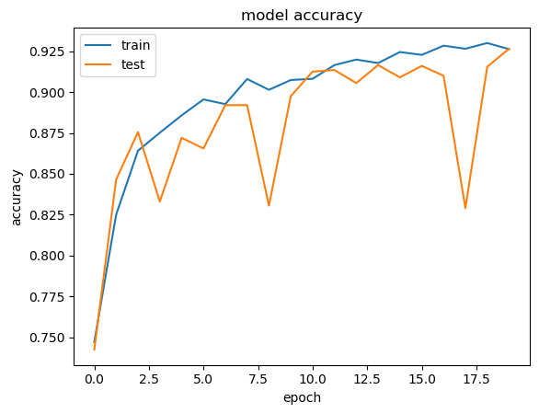
Custom CNN Test Results
Diff: 0.04
4 Layers
w/BN + X_init
Error difference - Much smaller (0.000…)
Accuracy improved - 0.5%

Slide 17
Deep learning Steps
3
5
Test Data Validation
Train model
Analysis + Improve
4
Source: https://agsft.com/wp-content/uploads/2016/06/FilterBigData.png , https://cdn-images-1.medium.com/max/1600/1*fk2ZjHyqYH04rLTgvQYs4A.png ,

Slide 18
Faster RCNN

Slide 19
Overview
Base feature layer: VGG/ResNet
Feature map shared by RPN and classifier
RPN : propose bounding boxes from the Feature Map
ROI pooling: Pool the feature map to 7 x 7 fixed size
FC layer to classify and regress the bouding boxes

Slide 20
Phase 1: Train a base model
We trained a VGG and with normalization ResNet base model to evaluate the learning capability by tellling whether the input image has ship or not
We have more than 104k training images and 89k test images with dimesion 764 x 764, to be resize to 600 x 600
VGG is faster and use less memory. VGG can reach 91.5% after just one epoch, ResNet can reach 92.2%. We choose VGG as our feature extractor as it train faster and less memory

Slide 21
VGG model
(300,300,64)
(150,50,128)
(9, 9, 512)
4096
4096
Ship
Detected
No Ship
Input
(600, 600, 3)
Fully Connected Layers
VGG16 Layers
VGG16 used for Classification
Batch Norm
Conv2D
Dense Layer
Max Pool
Flatten

Slide 22
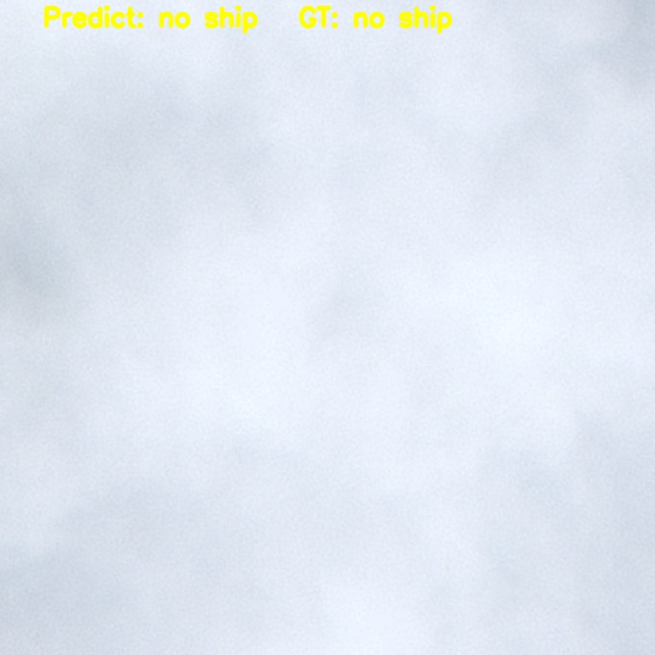
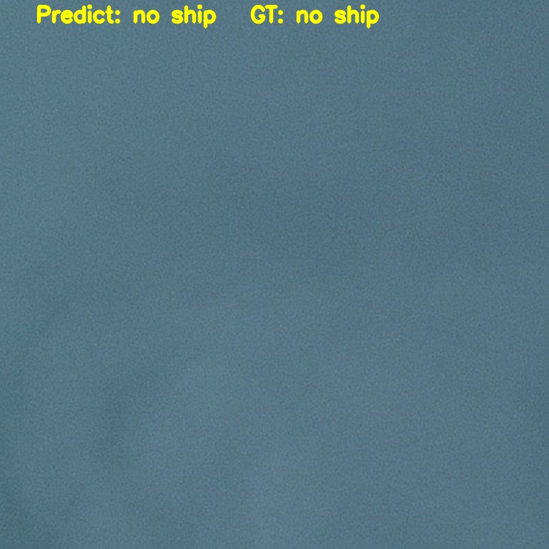
Demo

Slide 23
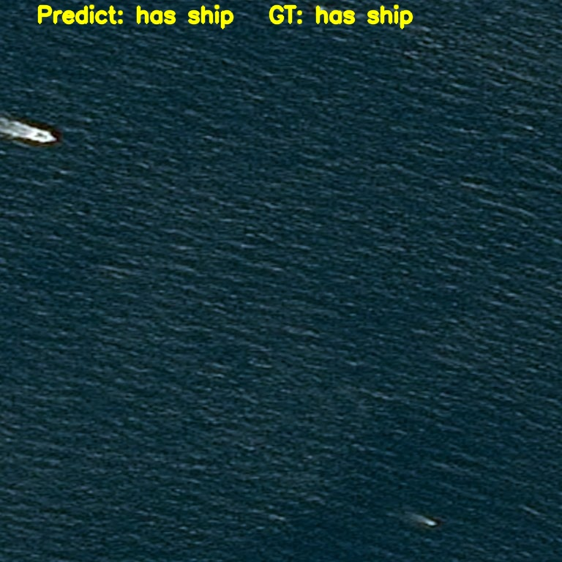
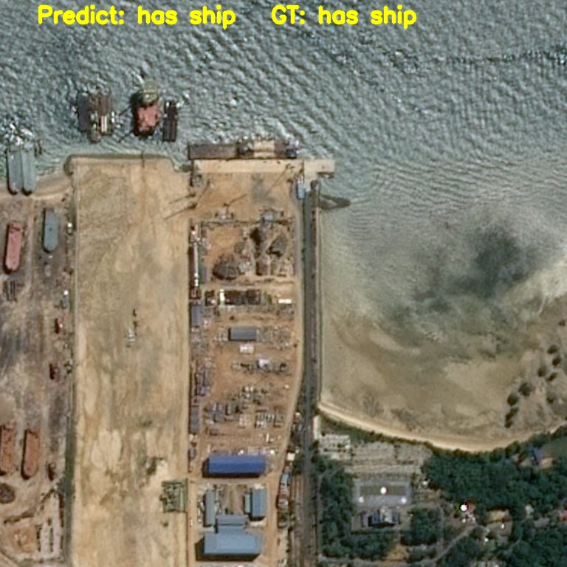
Demo

Slide 24
Proposing bounding boxes
After 4 times maxpool and channel expansion by base layer(VGG16), we get output feature 37 x 37 x 512.
Base on each point in 37 x 37 we generate 9 anchor(3 aspect ratio x 3 size). There are 37 x 37 x 9 = 12321 anchor with a stride of 16 on input image.
RPN layer generate x, y, h, w transformation coefficient and the score for each anchor.
Nms(Non-maximun suppresion) to filter out low score bbox.
Map the box back to feature map and perform ROI pooling to generate fix size 7 x 7 x 512 feautre map
Finally FC layers perform classification and bounding box regression

Slide 25
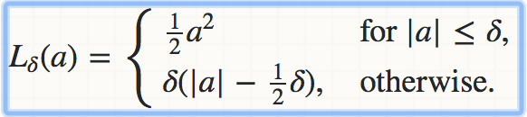
Loss function
Classifier: Cross-entrophy
Bounding box regression: smooth L1 loss
Use ground truth bounding box to generate ground truth transformation coefficients
Compute the lost to back propagate and update the weight

Slide 26
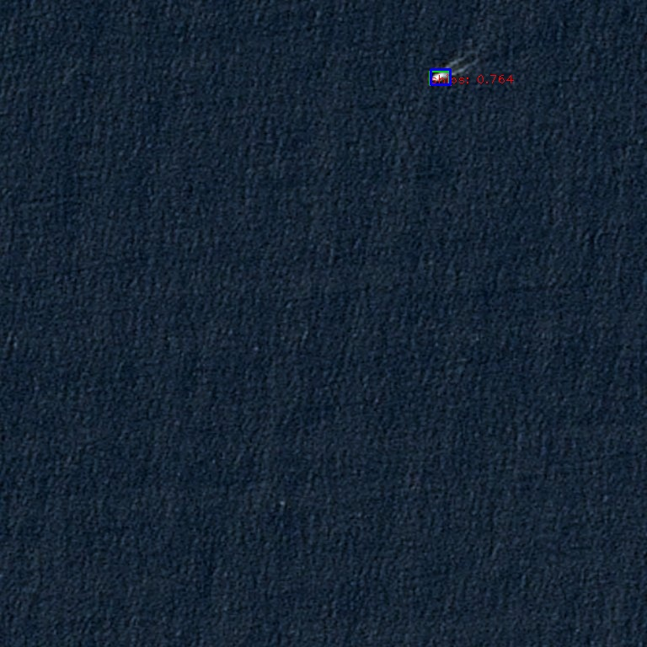
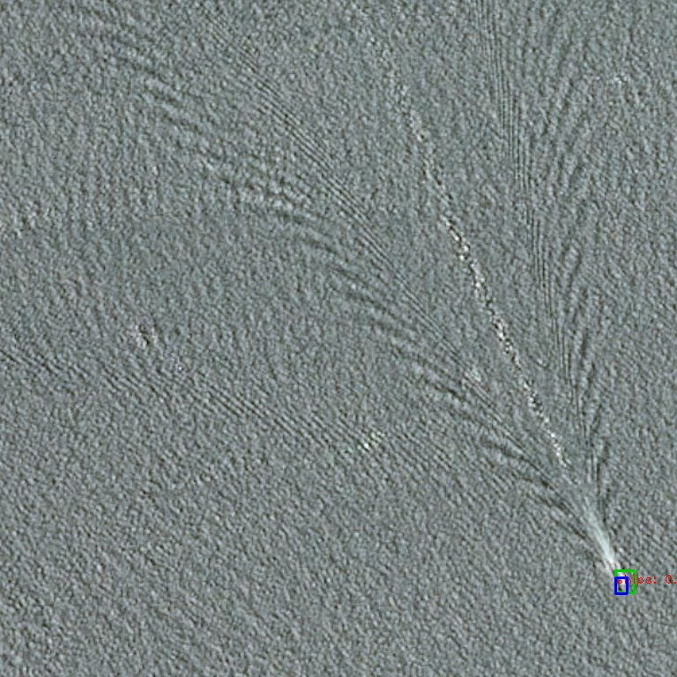
Demo

Slide 27
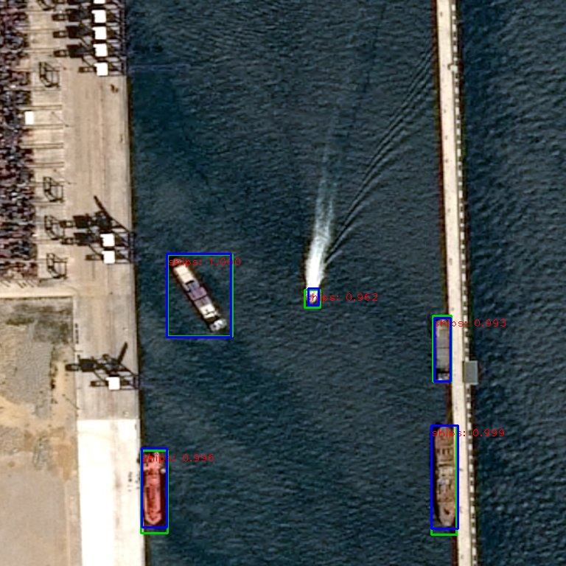
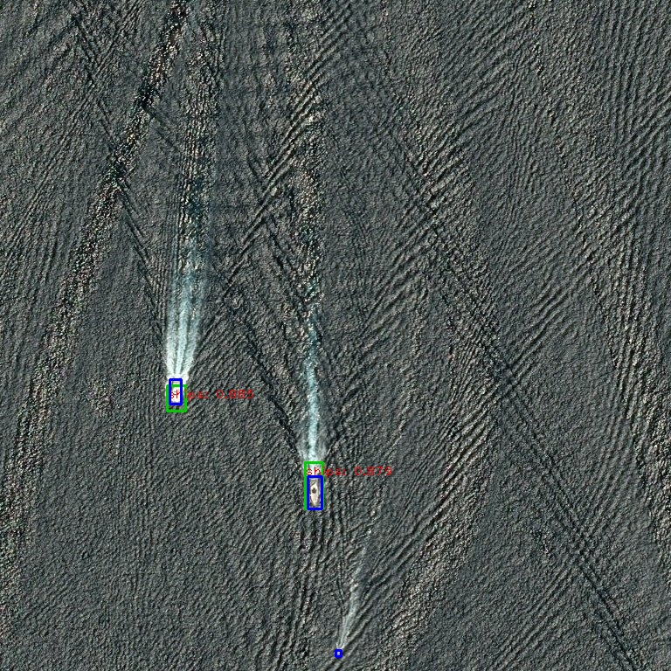
Demo

Slide 28
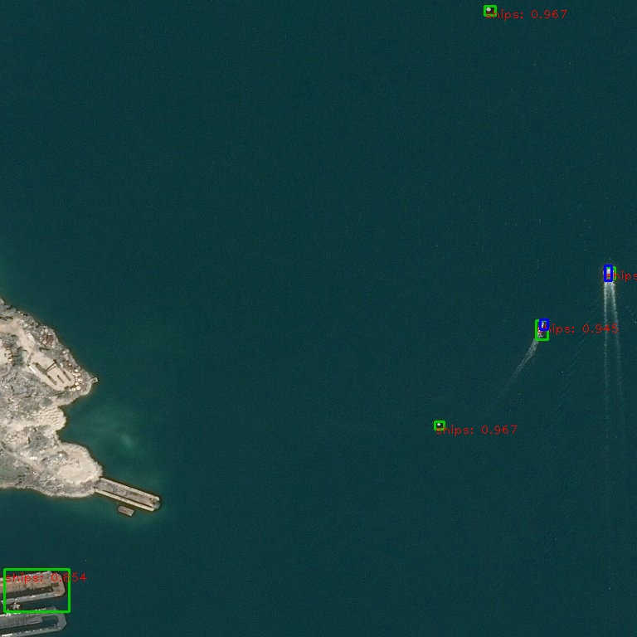
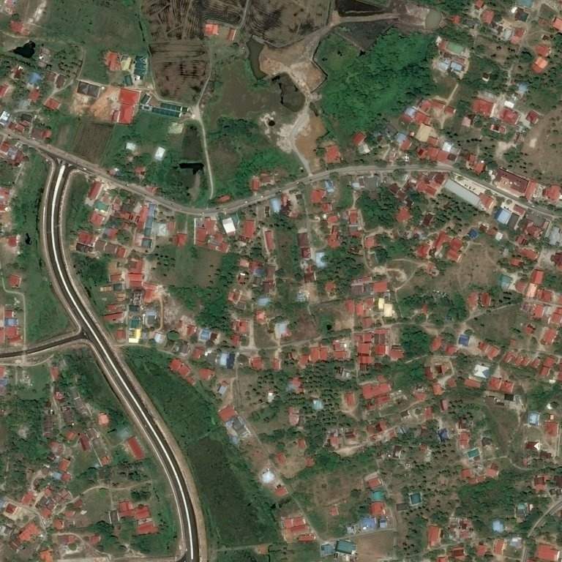
Demo

Slide 29
Evaluation of the network
True Positive: IOU > 0.5
Recall: True Positive / All ground truth boxes
Precision: True Positive / All Propose boxes above threshold

Slide 30
Evaluation of the network
Train set |  |  |  |  | Test set
confident level | epoch 2 | epoch 3 | epoch 4 | epoch 5 | epoch 5
0.4 | recall 54.298% precision 36.698% | recall 62.588% precision 46.060% | recall 64.784% prescion 52.534% | recall 66.227% prescion 52.885%
0.5 | recall 52.567% precision 41.745% | recall 61.992% precision 51.696% | recall 65.768% precision 57.600% | recall 67.657% prescion 57.153%
0.6 | recall 51.881% precision 48.063% | recall 61.992% precision 51.696% | recall 64.194% precision 62.454% | recall 66.626% precision 61.111% | recall 65.245% precision 59.546%
0.7 | recall 48.520% precision 53.928% | recall 59.769% precision 63.839% | recall 65.980% prescion 67.508% | recall 65.228% precision 66.391% | recall 63.930% precision 65.878%
0.8 | recall 46.291% precision 64.590% | recall 56.942% precision 69.062% | recall 58.801% prescion 70.614% | recall 62.677% prescion 70.738% | recall 61.702% precision 69.949%

Slide 31
Setup
Hardware:
CPU: intel i7-8700K
GPU: 2080ti
Software:
OS: Ubuntu 18.04 with CUDA 10.0
Docker: Nvidia docker 16.04 CUDA 9.0 image
Faster RCNN:
100mins/epoch

Slide 32
Visualization

Slide 33
Visualization - outline
The model with one conventional layer
Convolutional model with different dimension of kernel;
Convolutional model with different number of filter layers;
Convolutional model with one activation layer;
Convolutional model with one activation layer and one pooling layer (with different pooling sizes)
Visualization for model, Layers, and Kernel
the VGG16 model;
Visualization for layers;
Visualization for Kernel;

Slide 34
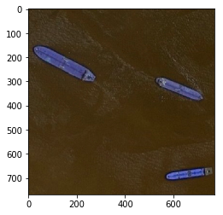
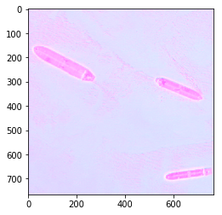
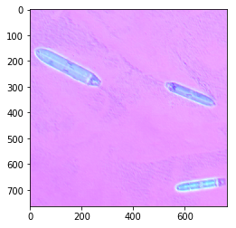
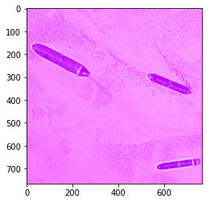
Model with one convolutional layer
With different dimension of kernel
Original Image
Size of kernel = (2, 2)
Size of kernel = (4, 4)
Size of kernel = (6, 6)

Slide 35
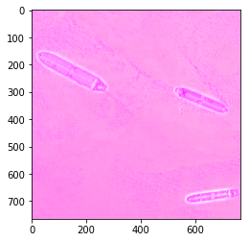
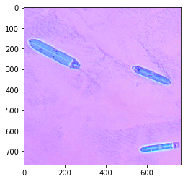
Model with one convolutional layer
With different number of filter layers
Original Image
Number = 3
Number = 4

Slide 36
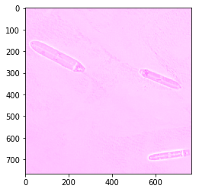
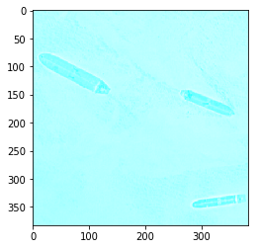
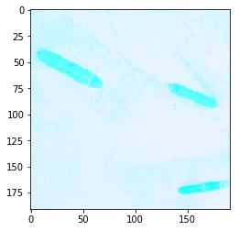
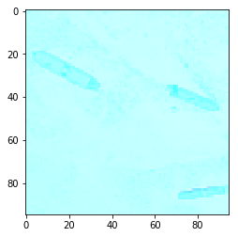
Model with one convolutional layer
With activation layer and pooling layer
With 1 activation layer
With 1 AL and Pooling layer (2,2)
Pooling layer (4,4)
Pooling layer (8,8)

Slide 37
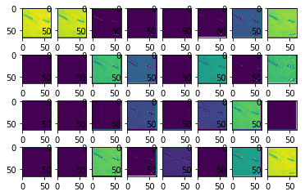
Model of VGG16 – Layer Visualization
Layer one

Slide 38
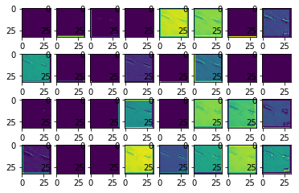
Model of VGG16 – Layer Visualization
Layer two

Slide 39
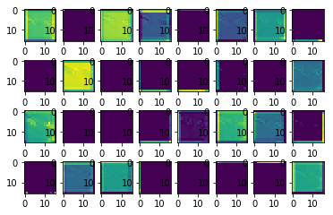
Model of VGG16 – Layer Visualization
Layer three

Slide 40
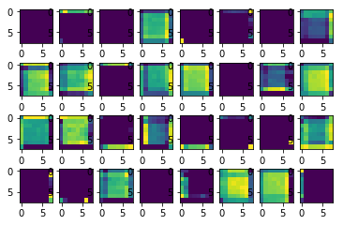
Model of VGG16 – Layer Visualization
Layer four

Slide 41
Model of VGG16 – Kernel Visualization

Slide 42
Summary
Gathered better understanding of the Datasets and proposed method to handle data imbalance
Successfully classified images with ~91% using VGG16 (with batch normalization)
Successfully implemented Faster RCNN to localize ships with bounding box
Visualization of individual VGG16 Layers to improve performance

Slide 43
Future Improvements
Increase size of dataset
Consider v2 dataset (50% more data)
Obtain raw satellite images
Transfer learning
Benchmark with existing algorithms
Submit to Kaggle competition
Further generalized for other image detection use cases

Slide 44


